Slide 1
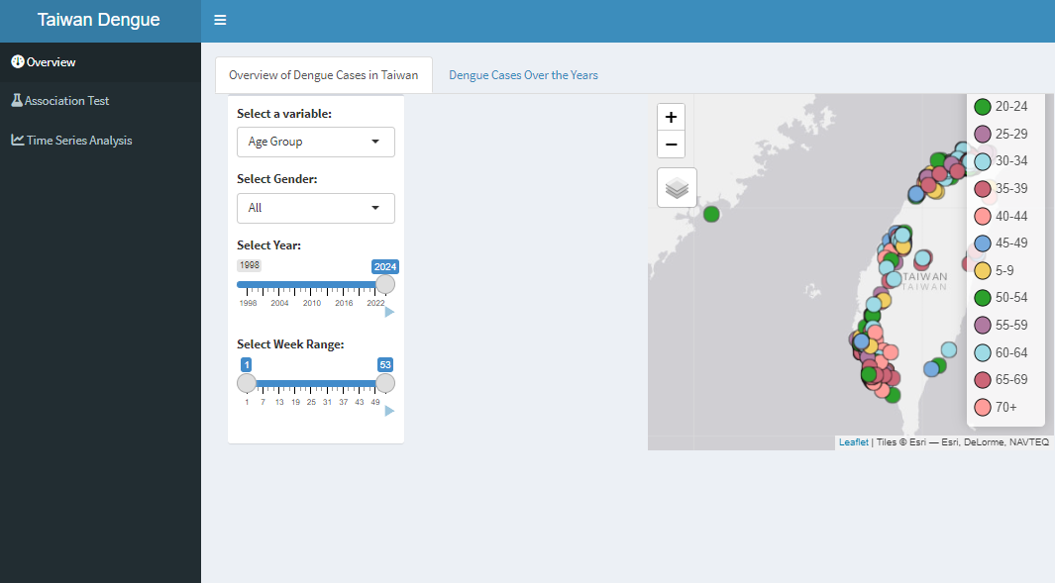
Drop-down to allow users to select a variable that they wish to visualise on the map.
Drop-down to allow users to further filter the dataset to visualise the distribution of dengue cases on map.
Slider option to allow users to select year and week range.
Map area to reflect the distribution of dengue cases across Taiwan.

Slide 2
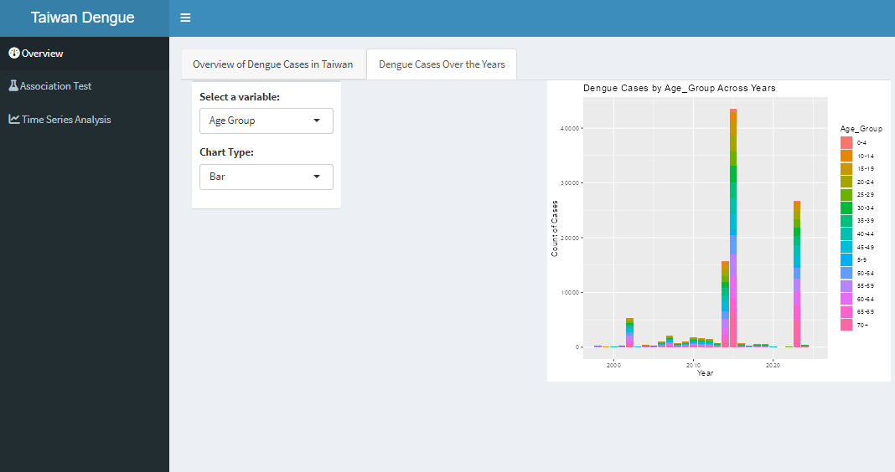
Drop-down to allow users to select a variable that they wish to visualise on the map.
Drop-down to allow users to select the chart type they wish to visualise.
Chart will reflect the distribution of dengue cases across years.
Data will be aggregated based on the selected variable.

Slide 3
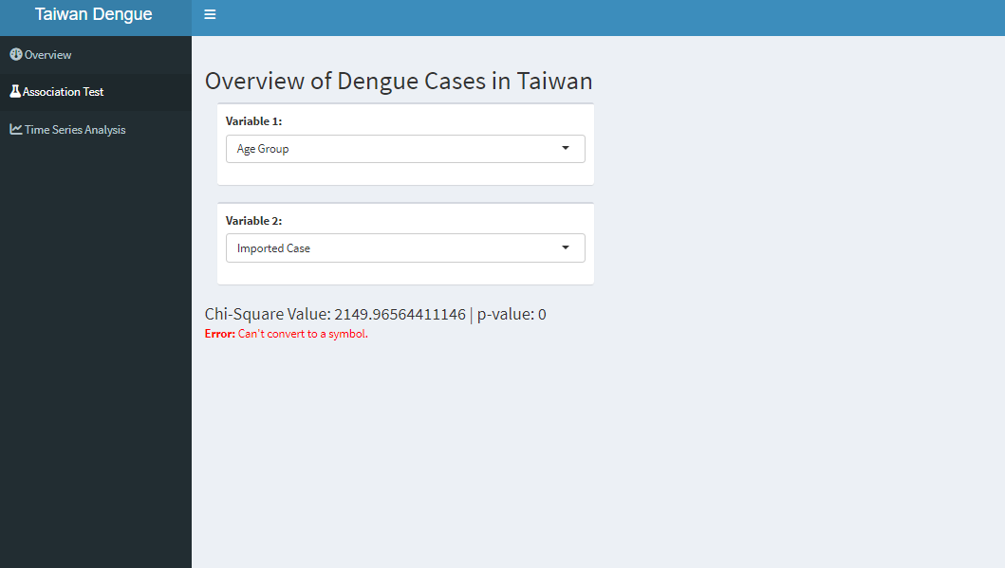
Drop-down selections to allow users to select the variables that they wish for the Chi-square test.
Results from Chi-square test.
Chart area for CDA results.

